Slide 1
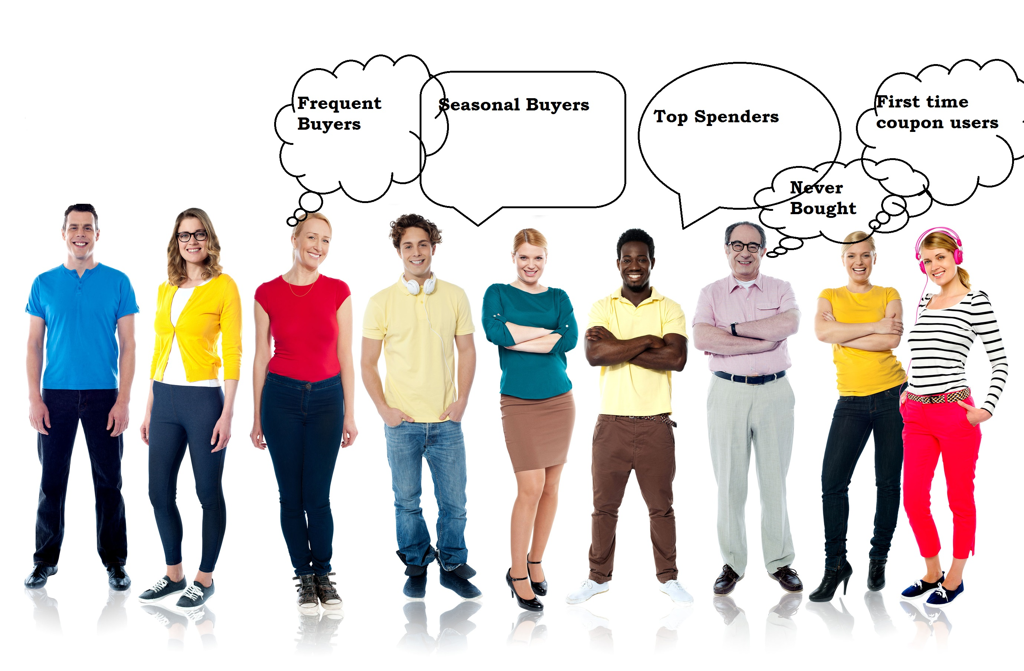
DAT8SYD Project Generating Shopper Insights from WiFi Data

Slide 2

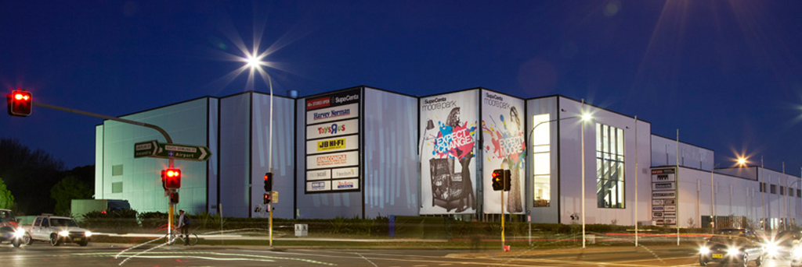
Objective
Generate insights into shoppers using location information from the public WiFi network
What products are they looking to buy?
What is their shopper journey through the centre?
Can we identify these shoppers for future promotions and marketing?

Slide 3
Data Sources
Location events captured from WiFi network
Smartphone emit ‘pings’ including MAC Address
Detected by specific access points
6 months of shopper activity
1 January to 30 June
31,638,322 location observations
Timestamp
MAC Address
Access Point
285, 415 shopper visits
111,534 unique MAC addresses/devices

Slide 4
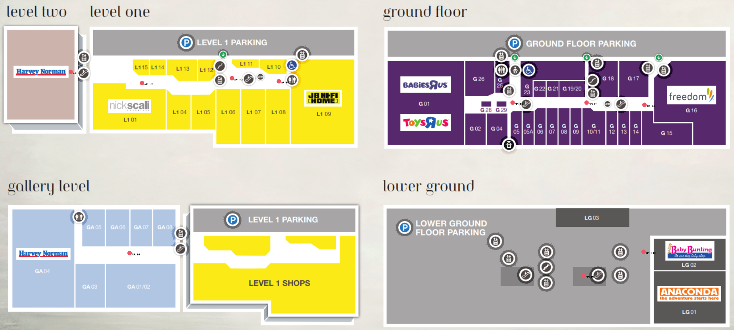
Floorplan

Slide 5
Data Preparation
Sessionisation¹
Convert location events into a contiguous visit
Calculate Zones¹
Area where access point is located
Calculate Dwell¹
Time spent in zone before moving to different zone
Duration¹
Total time spent in the shopping centre
Visits
Calculate number of visits over the period for the device
Arrival Time
Earliest time the device was detect on each day
Aggregation
Calculate total dwell per zone over all visits
¹ Insights Visitor Platform

Slide 6
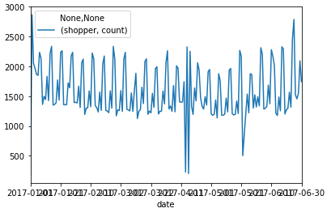
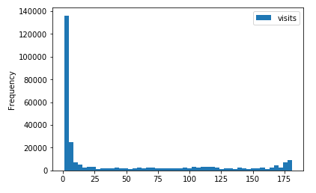
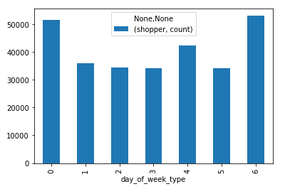
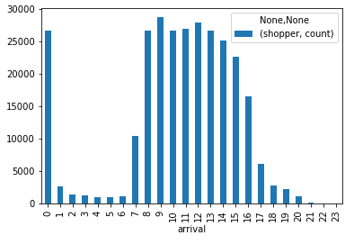
Data Analysis
2.6 visits per shopper
Avg Dwell per Zone (min)
Gallery King Furniture 5.35
Ground BBQ Ranch 3.45
Ground Dish Kiosk 20.66
Ground Freedom 4.47
Level 1 Dare Gallery 7.69
Level 1 JB HiFi 65.78
Level 1 Nick Scali 3.13
Level 2 Harvey Norman 34.56
Lower Ground Baby Bunting 4.93
Lower Ground Escalators 1.76

Slide 7
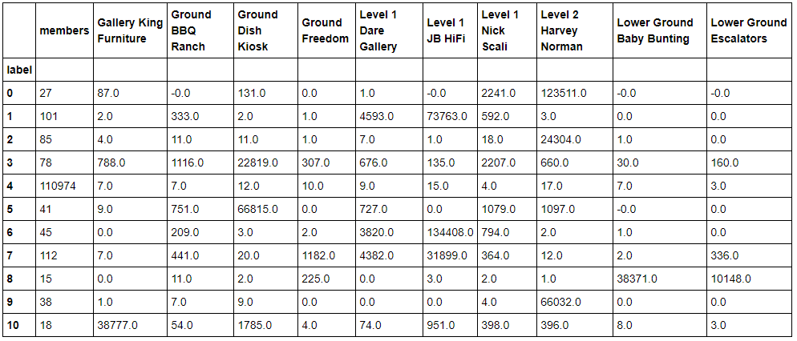
K-Mean Clustering Round 1

Slide 8
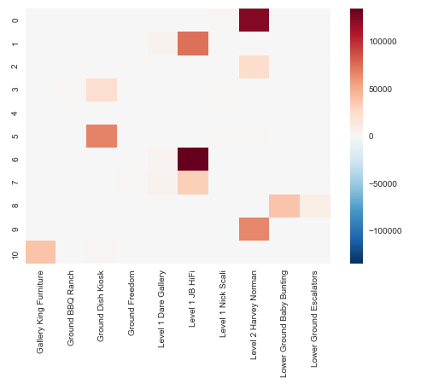
K-Mean Clustering Round 1

Slide 9
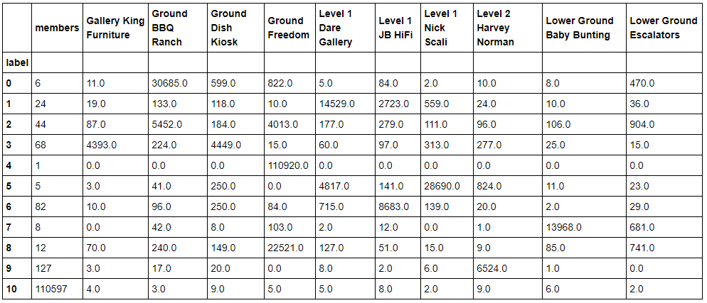
K-Mean Clustering Round 2

Slide 10
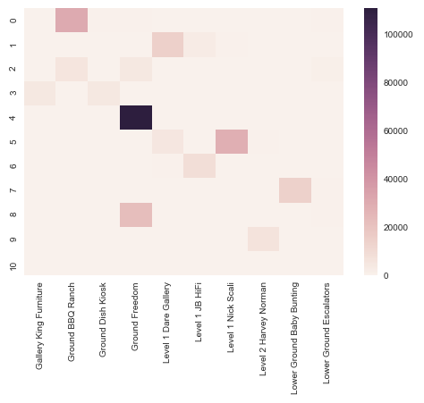
K-Mean Clustering Round 2

Slide 11
More Data Preparation
Exclude staff and static devices by assuming shoppers have…
Less than 20 visits
Less than 120 minutes in any one zone
Between than 30 minutes and 240 minutes total duration
More than 1 active zone
Analyse individual visits
38,782 shopper visits

Slide 12
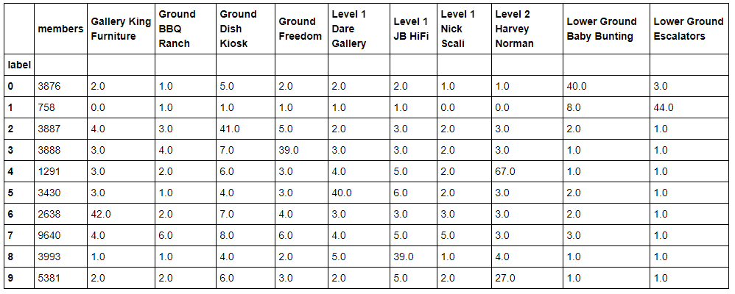
K-Mean Clustering Round 3

Slide 13
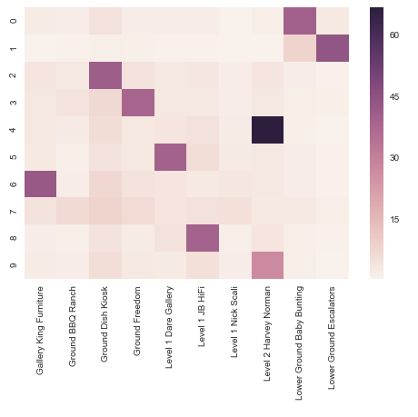
K-Mean Clustering Round 3

Slide 14
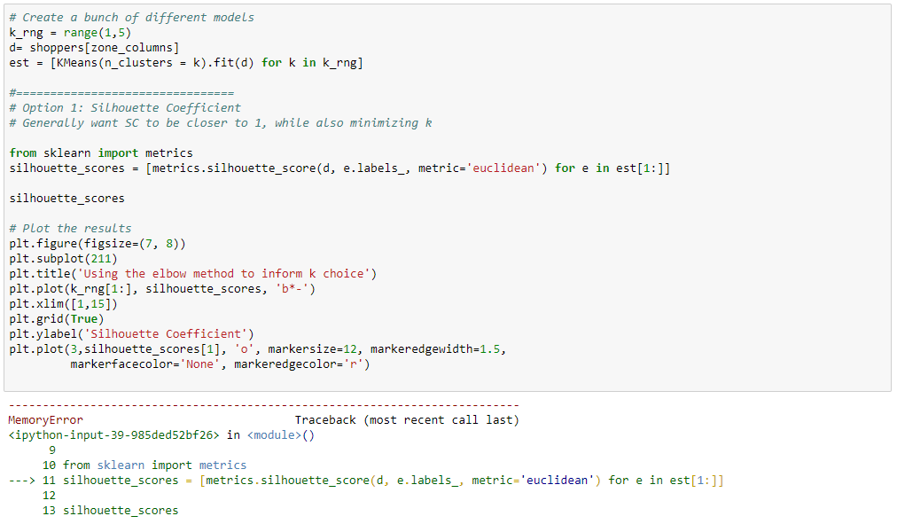
Silhouette Analysis

Slide 15
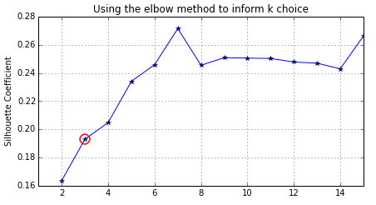
Silhouette Analysis AWS m4.4xlarge Instance @ $1,000 per month 16 CPU 64 GB RAM

Slide 16
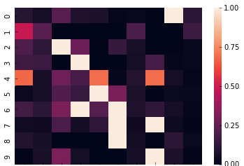
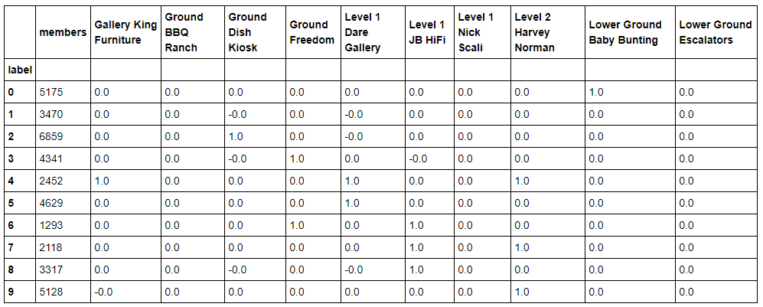
Data Scaling
Change data to Boolean
True if shopper spent more than 10 minutes in zone
Baby/Kids
Food/Bev
Furniture
Furniture
Furniture
Electronics
Electronics

Slide 17
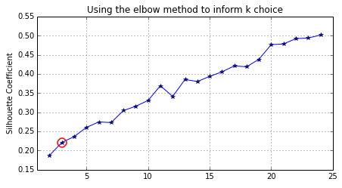
Silhouette Analysis

Slide 18
DBSCAN
Estimated number of clusters: 61
Silhouette Coefficient: -0.540

Slide 19
Next Steps
Look for more clusters
Try other clustering algorithms
Heirarchical Clustering
Agglomerative Clustering
Analyse merchant categories in each zone
Electrical
Homewares
Furniture
Bedding
Incorporate day of week and arrival time
Cohort analysis
Devices with the same path at the same time
Link to volunteered personal/demographic information

